Slide 1
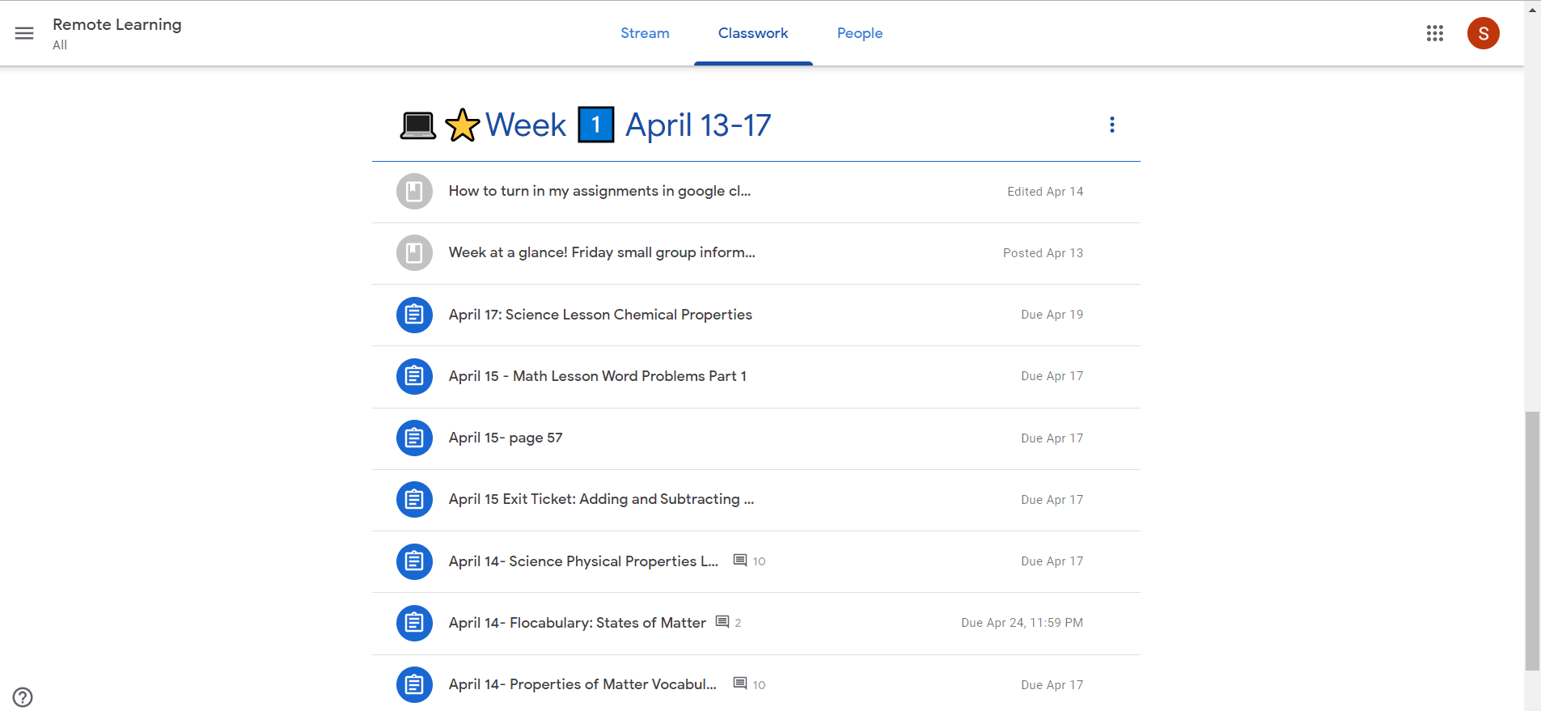
Check ALL your missing Assignments from week 1!
Gray: Turned in/ Completed
Just a Material to Look
Blue= MISSING/ not done
Incomplete

Slide 2
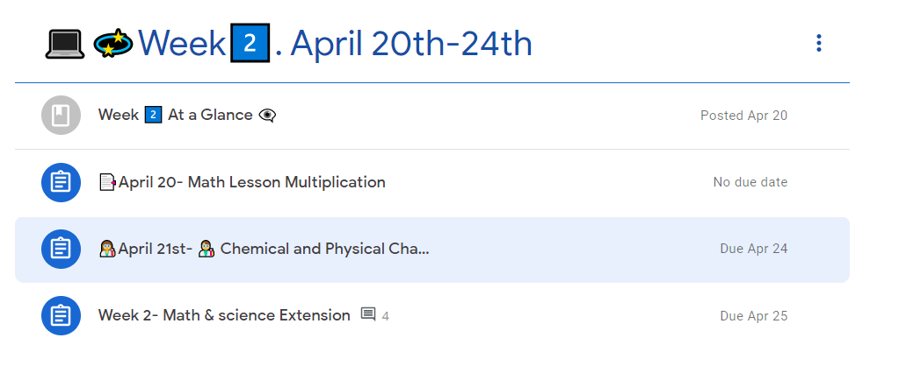
How do you Check your missing Assignments?
Click on the Assignment

Slide 3
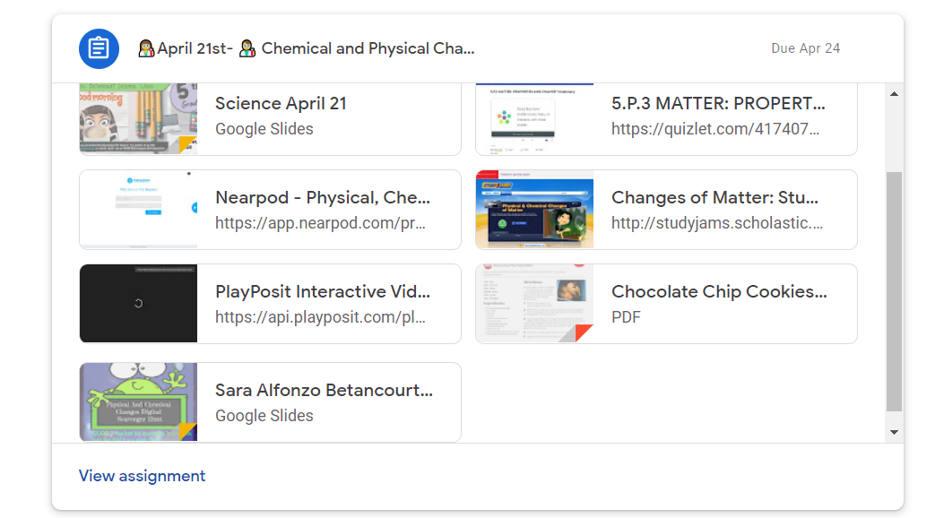
Once you click on the blue clipboard icon, it will show you all the materials for the lesson.
Click on view Assignment
To see what needs to be turned in
Make sure you scroll up/down to see all materials
If an Assignment
Has your name
You need to open it
and complete it

Slide 4
Needs to be opened
And completed
For evidence
Also found in your Google drive
This is the Complete ASSIGNMENT. HERE is your work!!!
Here you have my video and assignments
You can add a Google doc,
A google slide, a picture for your evidence
Google Forms
Are also
Considered evidence
FINISH
EVERYTHING
Any person in the class can read your comment to the assignment
You can unsubmit
If you mistakenly
Turn in
But have not finished
Message between you and your teachers

Slide 5
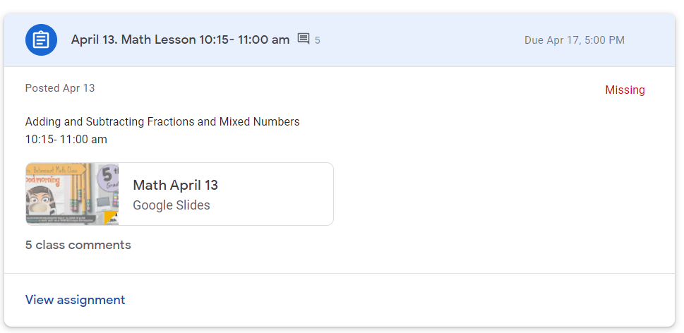
You can Check
If you need to complete something,
MARK as DONE or Turn in, after checking

Slide 6
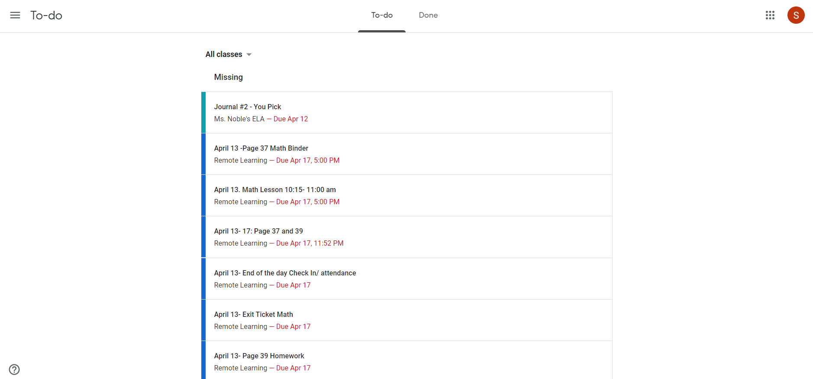
Your
Wake ID School
Account
See the due dates
That is the date that you have to turn it in

Slide 7
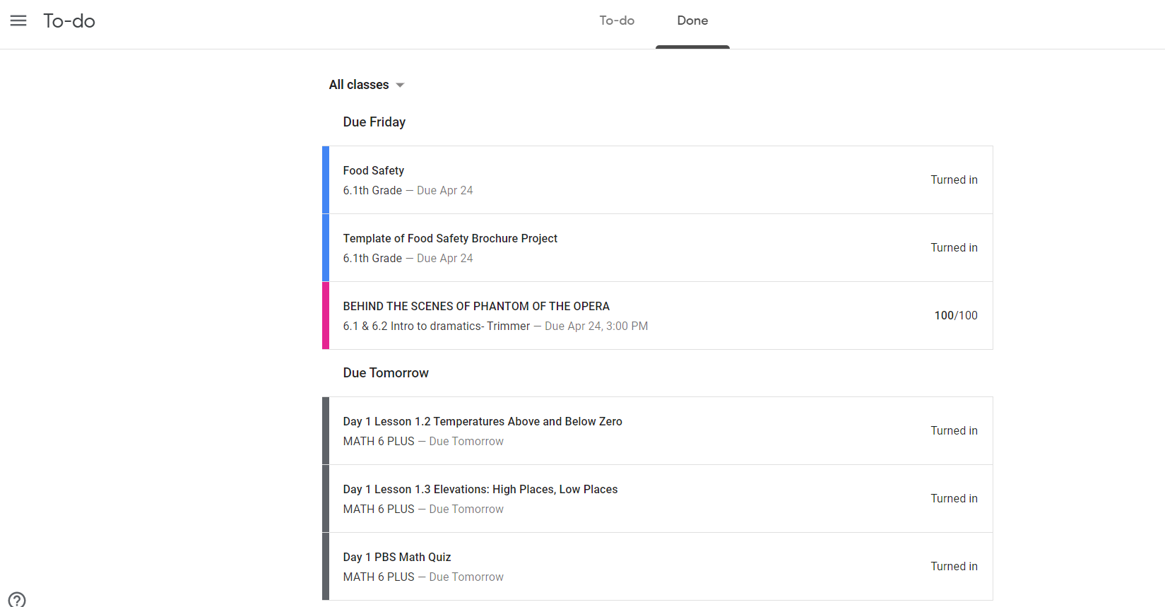
Evidence is completed and correct
Your work
Should
Look
Like this

Slide 8
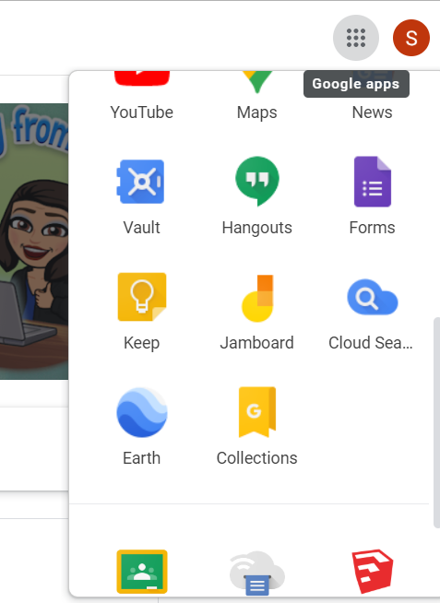
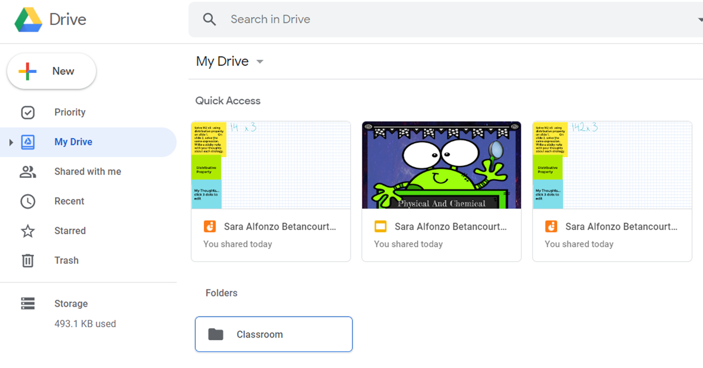
slides
You can find your Jamboard/ slides/ or documents for here
Or also in your google drive
In your folder called classroom
Click here

Slide 9
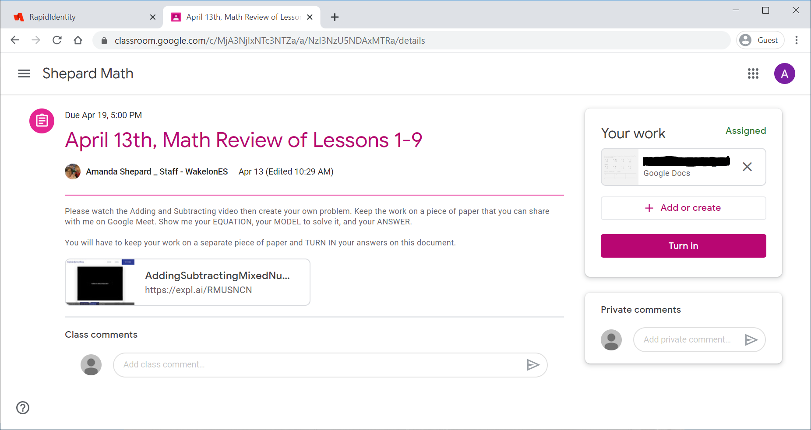
This is your worksheet
When your work is done, press this button.
PLEASE READ THIS:
This is where you will find a teacher video or powerpoint, watch before you try the worksheet
My feedback to you, ONLY you can see this.
You can ask questions here, or meet me in office hours at 1pm.

